Slide 1
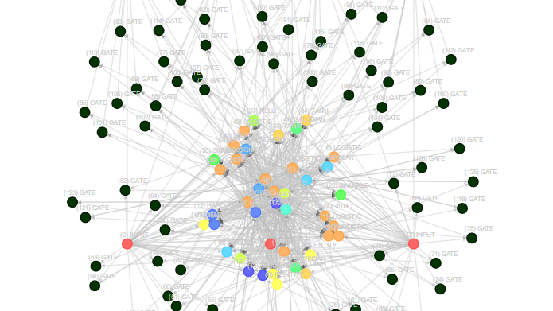
Research Project Presentation
AI Avatar for Academic Advising
using Fine-Tuned Large Language Model
Integrating RAG, Voice Interaction, and Embodied AI for Intelligent Academic Support
Student
Supervisor
Jet Saw Jun Jie
Dr. Tan Wooi Haw
Student ID
Faculty
1231303401
Artificial Intelligence and Engineering

Slide 2
Context & Motivation
Introduction
Academic Advising Today
Academic advising is a critical support service in higher education, helping students understand programme structures, subject prerequisites, and graduation requirements.
The Opportunity
Traditional Methods
Recent advances in artificial intelligence provide an opportunity to automate routine academic advising while maintaining accuracy and accessibility.
Traditionally, advising relies on manual consultations and static documents such as handbooks and PDFs, creating bottlenecks during peak periods.
This project proposes an AI-based academic advising system that enables natural language and voice-based interaction, with responses grounded in official faculty documents.
Current Challenges
During peak academic periods, advisors experience high workloads while students face delays in receiving accurate information.

Slide 3
Goals & Outcomes
Project Objectives
Primary Objectives
1
Fine-Tune LLM
2
Implement RAG
3
Voice Interaction
Fine-tune a Large Language Model using faculty and programme information for domain-specific accuracy.
Implement a Retrieval-Augmented Generation pipeline to ensure factual accuracy in responses.
Support natural two-way voice interaction for accessible academic advising.
Secondary Objectives
Reduce Workload
Improve Response Time
Enhance Engagement
Reduce academic staff workload by automating routine inquiries.
Improve response time for students seeking academic guidance.
Enhance user engagement using an AI avatar interface.

Slide 4
Development Strategy
Project Overview
1
Phase 1
2
Phase 2
HIVE Academic Chatbot
AI Avatar Development
Backend Intelligence
Unity Avatar Interface
Fine-tuned Large Language Model optimized for academic domain knowledge.
Unity-based avatar providing visual presence and interactive experience.
Speech Integration
RAG Pipeline
Speech-to-text and text-to-speech for natural voice-based interaction.
Document-grounded responses ensuring factual accuracy from official sources.
Lip Synchronisation
Real-time lip synchronisation aligning avatar facial movement with speech.
Semester 1: Week 3-13
Semester 2: Week 1-13
Phased Approach Rationale: This sequential development ensures system accuracy and reliability are established before introducing visual and voice interaction layers.

Slide 5
Literature Review 1 of 4
Large Language Models
Capabilities
Key Insights
LLMs excel at language understanding and generation
Large Language Models (LLMs) demonstrate strong performance in natural language understanding and conversational tasks.
Few-shot learning enables task adaptation
Probabilistic generation risks factual errors
Brown et al. (2020) showed that large transformer-based models can perform a wide range of tasks through few-shot learning, demonstrating remarkable generalization capabilities.
Domain-specific applications require verification
Limitations
APA Citation
However, LLMs generate responses based on probabilistic language patterns rather than verified knowledge.
(Brown et al., 2020; OpenAI, 2023)
This can lead to hallucinated or incorrect information when applied to domain-specific tasks such as academic advising (OpenAI, 2023).
Implication: LLMs need complementary mechanisms to ensure factual accuracy in academic contexts.

Slide 6
Literature Review 2 of 4
Fine-Tuning
What is Fine-Tuning?
Limitations
Fine-tuning adapts a pre-trained language model to a specific domain by training it on curated datasets, enabling specialization.
However, fine-tuning alone does not guarantee factual correctness or adaptability to changing academic policies.
Devlin et al. (2019) demonstrated that fine-tuning significantly improves domain relevance and downstream task performance across various NLP applications.
Models may still generate plausible-sounding but incorrect information, especially when policies are updated or edge cases arise (OpenAI, 2023).
Performance Impact
Academic Applications
In academic applications, fine-tuning helps models understand faculty-specific terminology , course structures, and academic policies that general models may not capture.
Domain Relevance
Task Performance
Factual Accuracy
Policy Adaptability
APA Citation:
(Devlin et al., 2019; OpenAI, 2023)

Slide 7
Literature Review 3 of 4
Retrieval-Augmented Generation (RAG)
What is RAG?
RAG Workflow
1
Document Ingestion → Process academic documents
Retrieval-Augmented Generation (RAG) combines document retrieval with text generation, creating a hybrid approach that grounds AI responses in verified sources.
2
Embedding & Indexing → Convert to vector representations
Lewis et al. (2020) demonstrated that RAG significantly improves factual accuracy in knowledge-intensive tasks by grounding responses in retrieved documents rather than relying solely on parametric knowledge.
3
Query Retrieval → Find relevant document chunks
4
Grounded Generation → Generate contextually accurate responses
Why RAG for Academic Advising?
Key Benefits
RAG is particularly suitable for academic advising because it ensures answers are aligned with official programme and faculty documents rather than relying solely on model memory.
Reduces hallucination through document grounding
Enables real-time updates to knowledge base
Provides source attribution for transparency
APA Citation:
(Lewis et al., 2020)

Slide 8
Literature Review 4 of 4
Voice & Avatar Interaction
Voice Interaction
Lip Synchronisation
Voice-based interaction improves accessibility and usability in conversational systems, enabling hands-free operation.
Lip synchronisation further improves realism by aligning speech with avatar facial movement.
Radford et al. (2023) showed that Whisper provides robust speech recognition across accents and noisy environments, making it suitable for diverse student populations.
Taylor et al. (2017) showed that accurate lip-sync significantly enhances perceived naturalness and user engagement in virtual agents.
Integration Benefits
Embodied Agents
Accessibility
Voice enables hands-free interaction
Embodied conversational agents enhance engagement and trust compared to text-only systems.
Engagement
Avatar creates emotional connection
Cassell et al. (2000) demonstrated that visual presence creates stronger user connection and improves information retention in advisory contexts.
Trust
Visual presence builds credibility
APA Citation:
(Radford et al., 2023; Cassell et al., 2000; Taylor et al., 2017)

Slide 9
Synthesis & Opportunity
Research Gap
From Existing Research
This Project's Contribution
LLM Hallucination
This project addresses these gaps through an integrated academic advising system that combines:
LLMs alone are prone to generating incorrect information
Fine-Tuning Limits
Fine-tuned LLM for domain expertise
Fine-tuning improves language behavior but not factual grounding
RAG pipeline for factual accuracy
RAG-Avatar Gap
Voice interaction for accessibility
RAG improves accuracy but is rarely combined with avatars
Lip-synchronised avatar for engagement
Integration Void
Few systems integrate LLM + RAG + voice + avatar for academic advising
Novelty: First integrated system combining all four components specifically for academic advising.

Slide 10
Technical Design
System Architecture Overview
Voice-Enabled Frontend
Backend API Server
RAG Pipeline
User interface with speech input/output capabilities
Central orchestration and request handling
Document retrieval and context injection
Fine-Tuned LLM
Unity AI Avatar
Architecture Benefits
Domain-optimized language model for academic content generation
Visual interface with real-time lip synchronisation
Modular design
Scalable components
Easy maintenance
Design Principle: The architecture is modular and scalable , allowing independent updates to each component without disrupting the entire system.

Slide 11
Retrieval-Augmented Generation
RAG Pipeline (Overview)
Pipeline Objective
The Retrieval-Augmented Generation pipeline ensures factual accuracy through a structured six-stage process that separates knowledge retrieval from language generation.
Six-Stage Process
1
QA Pair Generation
2
Document Chunking
3
Chunk Differentiation
Convert documents into structured Q&A format
Split into small semantic units
Tag by academic category
4
Embedding
5
Retrieval
6
Answer Generation
Convert to vector representations
Similarity search for relevant chunks
Generate grounded responses
Key Principle: This pipeline separates knowledge retrieval from language generation , ensuring responses are grounded in verified documents.

Slide 12
Implementation Details
RAG Pipeline (Detailed Steps)
1
QA Pair Generation
4
Embedding
Convert academic documents into structured question-answer pairs, creating a queryable knowledge base.
Convert chunks into vector representations using embedding models for semantic similarity search.
2
Document Chunking
5
Retrieval
Split documents into small semantic units that preserve context while enabling precise retrieval.
Retrieve relevant chunks using similarity search based on user query embedding.
3
Chunk Differentiation
6
Answer Generation
Tag chunks by academic category (programme structure, prerequisites, policies) for targeted retrieval.
Generate responses grounded in retrieved content, ensuring factual accuracy and source attribution.
Outcome: Each stage builds upon the previous, creating a robust pipeline that minimizes hallucination while maintaining natural language fluency.

Slide 13
Phase 1 of 2
Project Timeline: HIVE Academic Chatbot
Semester 1: Week 3 – Week 13
3-4
Requirement Analysis
7-8
RAG Implementation
11-12
System Testing
Week 3 – 4
Week 7 – 8
Week 11 – 12
Programme structure analysis
Document chunking
Hallucination evaluation
Course prerequisites mapping
Embedding model setup
Retrieval accuracy testing
Faculty policy collection
Vector database integration
13
Phase 1 Complete
5-6
Data Preprocessing
9-10
LLM Fine-Tuning
Week 13
Week 5 – 6
Week 9 – 10
HIVE Chatbot Fully Functional
Document cleaning & formatting
Base model selection
QA pair generation
Training on academic data

Slide 14
Phase 2 of 2
Project Timeline: AI Avatar Development
Semester 2: Week 1 – Week 13
1-2
Unity Setup
7-8
Lip Synchronisation
11-12
User Testing
Week 1 – 2
Week 7 – 8
Week 11 – 12
Environment configuration
Phoneme extraction
Interaction evaluation
System architecture planning
Viseme mapping
Usability assessment
Real-time sync
3-4
Avatar Integration
13
Final Validation
Week 3 – 4
9-10
Backend Integration
Week 13
3D avatar import & setup
Week 9 – 10
System validation
Animation control system
Unity-HIVE API connection
Presentation prep
End-to-end testing
Final submission
5-6
Speech Integration
Week 5 – 6
Speech-to-text (Whisper)
Text-to-speech setup

Slide 15
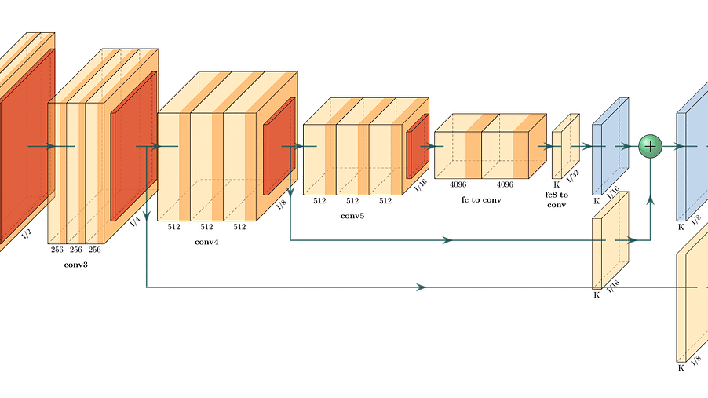
Summary & Impact
Conclusion
Project Value Proposition
This project demonstrates that combining fine-tuned Large Language Models with Retrieval-Augmented Generation and a Unity-based AI avatar can deliver accurate, accessible, and engaging academic advising support.
Reliability
Accuracy
Experience
The phased development approach ensures system reliability through incremental validation at each stage.
RAG pipeline significantly reduces hallucination by grounding responses in official documents.
AI avatar with voice interaction and lip-sync enhances user engagement and accessibility.
Future Impact: This system has the potential to transform academic advising by providing 24/7 intelligent support while reducing staff workload and improving student satisfaction.

Slide 16
Academic Sources
References
APA 7th Edition
Brown, T., Mann, B., Ryder, N., et al. (2020). Language models are few-shot learners. Advances in Neural Information Processing Systems, 33, 1877–1901.
Devlin, J., Chang, M.-W., Lee, K., & Toutanova, K. (2019). BERT: Pre-training of deep bidirectional transformers for language understanding. NAACL-HLT.
Lewis, P., Perez, E., Piktus, A., et al. (2020). Retrieval-augmented generation for knowledge-intensive NLP tasks. NeurIPS.
OpenAI. (2023). GPT-4 technical report. https://arxiv.org/abs/2303.08774
Radford, A., Kim, J. W., Hallacy, C., et al. (2023). Whisper: Robust speech recognition via large-scale weak supervision. https://arxiv.org/abs/2212.04356
Cassell, J., Sullivan, J., Prevost, S., & Churchill, E. (2000). Embodied conversational agents. MIT Press.
Taylor, S., Theobalt, C., & Matthews, I. (2017). Deep learning for facial animation from speech. ACM Transactions on Graphics (SIGGRAPH).
Thank You
Questions & Discussion

